Slide 1
Transcription in
Prokaryotes & Eukaryotes

Slide 2
Gene Expression
There are 4 major events that occur during the process of gene expression
  Transcription
  RNA processing
  Translation
  Protein processing

Slide 3
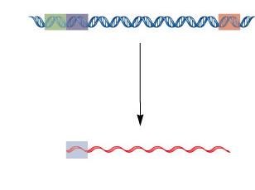
A Gene is a Transcription Unit
Promoter
Regulatory
sequence
Terminator
DNA
Transcription
mRNA 5′
3′
Start
codon
Many
codons
Stop
codon
Ribosomal-
binding site

Slide 4
Prokaryotic Gene Structure
Shine-Delgarno
box
Stop Codon
TAA, TAG, TGA
Shine-Delgarno
box
+1
ATG
ATG
Stop Codon
DNA
Cis-Regulatory
Elements
Coding Sequence = ORF 1
Coding Sequence = ORF 2
USE/Promoter
/Operator
5’ UTR = Leader
sequence
Protein A
Spacer = 5’UTR
of 2nd cistron
Protein B
Cistron 1
Cistron 2
Regulatory Sequences
Structural or Coding Sequences
Termination
sequence
Regulatory and Coding Sequence Unit = Operon
Polycistronic structure

Slide 5
Prokaryotic Gene Structure
Shine-Delgarno
box
Shine-Delgarno
box
Stop Codon
TAA, TAG, TGA
+1
Stop Codon
TAA, TAG, TGA
ATG
ATG
DNA
Cis-Regulatory
Elements
Coding Sequence= ORF
Coding Sequence= ORF
USE/Promoter
/Operator
Protein A
Protein B
Terminator
sequence
5’ UTR = Leader
sequence
Spacer = 5’UTR
of 2nd cistron
Cistron 1
Cistron 2
TRANSCRIPTION
5’ UTR = Leader
sequence
Spacer
Polycistronic
mRNA
ORF Protein A
ORF Protein B
+1
AUG
AUG
Shine-Delgarno
box
Stop Codon
UAA, UAG, UGA
Shine-Delgarno
box
Stop Codon
UAA, UAG, UGA

Slide 6
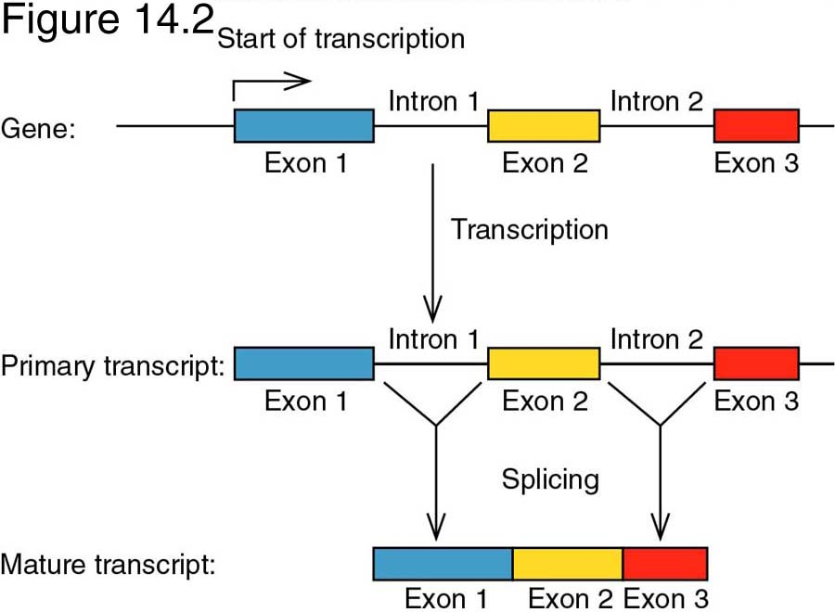


Eukaryotic Gene Structure
Start Codon ATG (Kozak’s consensus)
Stop Codon
TAA, TAG, TGA
Cis-Regulatory Elements
Exon1
Exon2
Exon3
Promoter/
Enhancer
5’ UTR
3’ UTR
Exon1
Exon2
Exon3
Start Codon
Stop Codon
polyA tail
Exon1
Exon2
Exon3
AAAAAAAA
5’ UTR
3’ UTR
Monocistronic structure

Slide 7
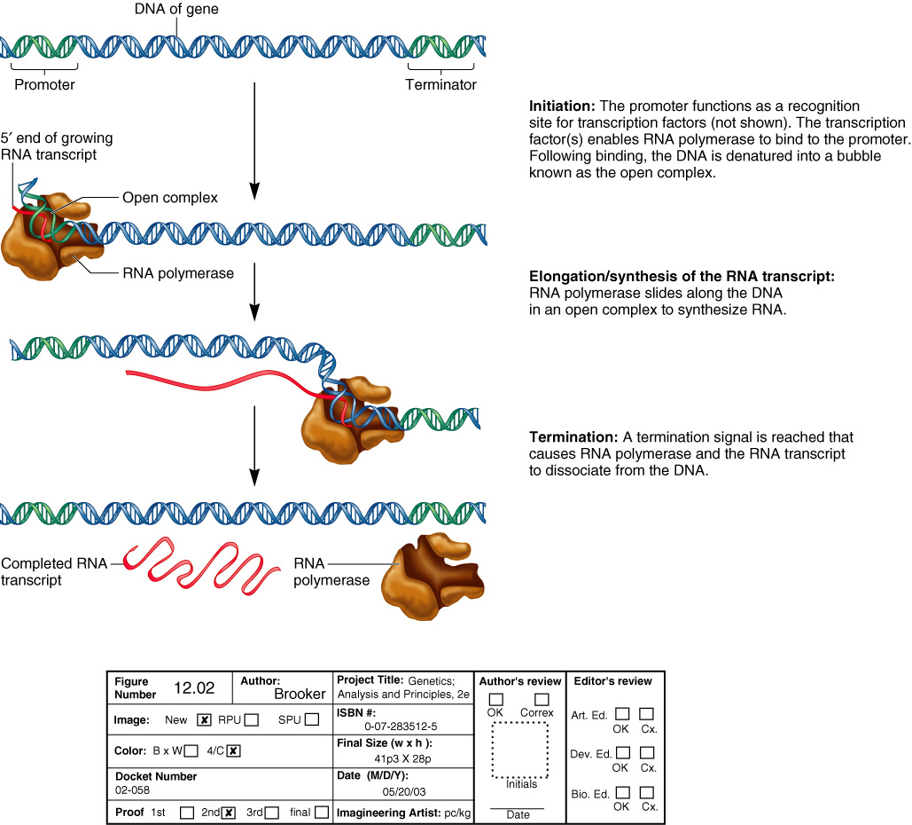
Transcription Proceeds Through 3 Steps
Initiation
Transcription factors & RNA polymerase recognize & bind the promoter
DNA adjacent to the promoter is denatured forming the open promoter complex
Elongation
RNA polymerase moves along the DNA in synthesizing a RNA transcript. Synthesis is 5’→3’ – Only 1 strand of DNA is read as a template.
Termination
A termination signal is reached causing RNA polymerase to dissociated from the DNA

Slide 8

Initiation
RNA polymerase
Transcription factors
Promoter DNA
  RNAP binding sites
  Operator – repressor binding
  Other TF binding sites
Start site of transcription is +1
α α β β’σ

Slide 9
Initiation
RNA polymerase
  4 core subunits
  Sigma factor (σ)–
  determines promoter
  specificity
  Core + σ = holoenzyme
  Binds promoter sequence
  Catalyzes “open complex” and transcription of DNA to RNA

Slide 10
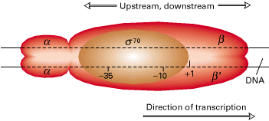
RNAP binds specific promoter sequences
Sigma factors recognize consensus
-10 and -35 sequences

Slide 11
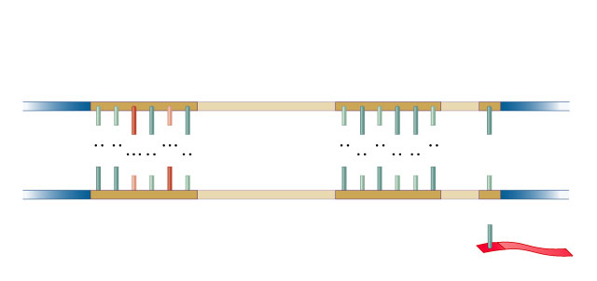
A Prokaryotic Promoter
Coding strand
Transcriptional
start site
Promoter
–35 sequence
–10 sequence
+1
5′
3′
T
T
G
A
C
A
T
A
T
A
A
T
A
A
A
G
A
A
A
T
C
T
T
T
T
T
3′
5′
A
Template strand
5′
3′
RNA
Transcription

Slide 12
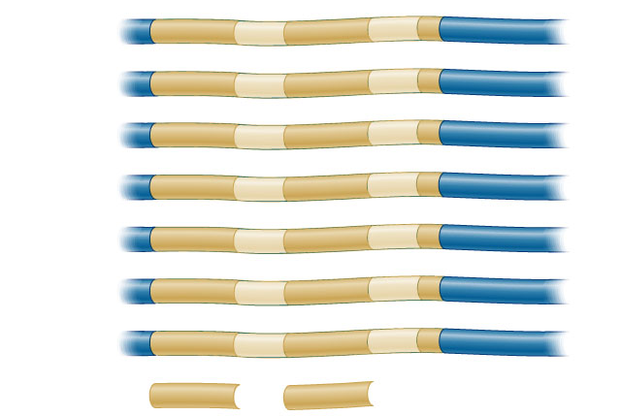
Reaching A Consensus
–35 region
–10 region
+1
Transcribed
lac operon
TTTACA
N₁₇
TATGTT
N₆
A
lacI
GCGCAA
N₁₇
CATGAT
N₇
A
trp operon
TTGACA
N₁₇
TTAACT
N₇
A
rrnX
TTGTCT
N₁₆
TAATAT
N₇
A
recA
TTGATA
N₁₆
TATAAT
N₇
A
lexA
TTCCAA
N₁₇
TATACT
N₆
A
tRNA^{tyr}
TTTACA
N₁₆
TATGAT
N₇
A
Consensus
TTGACA
TATAAT

Slide 13
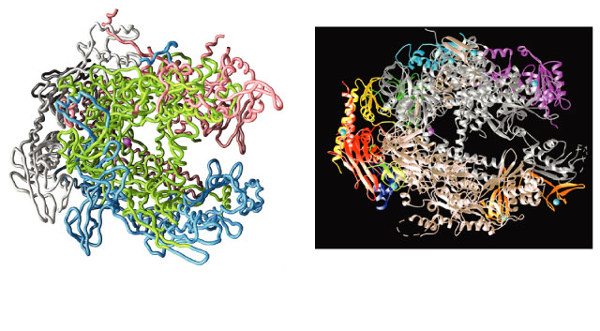
RNA Polymerases
Structure of a bacterial
RNA polymerase
Structure of a eukaryotic
RNA polymerase II

Slide 14
RNA Polymerases
Differences between eukaryotes & prokaryotes
Prokaryotes
  1 enzyme with 4 subunits
    2 α’s, 1 β, & 1 β’
    actual polymerase function
  Sigma factors (σ )
    recognize & bind promoter DNA sequence
Eukaryotes
  3 separate holoenzymes – each has ~12 subunits
    RNA Pol I – 28S, 18S, 5.8S rRNA
    RNA Pol II – mRNA, snRNA
    RNA Pol III – tRNA, 5S rRNA
  3 sets of basal transcription factors
    recognize promoter DNA sequences

Slide 15
The Process of Transcription
Initiation
  Where/when most regulation of gene expression occurs
  Different between prok:s & euk:s
Elongation
  Essentially same between prok:s & euk:s
  Some regulation, more in prok:s than euk:s
Termination
  Different between prok:s & euk:s
  Some regulation
Prok:s-prokaryote
Euk:s-eukaryotes

Slide 16
Elongation
Once the RNA polymerase has synthesized a short stretch of RNA (~ 10 nt), transcription shifts into the elongation phase.
This transition requires further conformational change in polymerase that leads it to grip the template more firmly.
Functions: synthesis RNA, unwinds the DNA in front, re-anneals it behind, dissociates the growing RNA chain

Slide 17
Termination
After the polymerase transcribes the length of the gene (or genes), it will stop and release the RNA transcript.
In some cells, termination occurs at the specific and well-defined DNA sequences called terminators. Some cells lack such termination sequences.

Slide 18
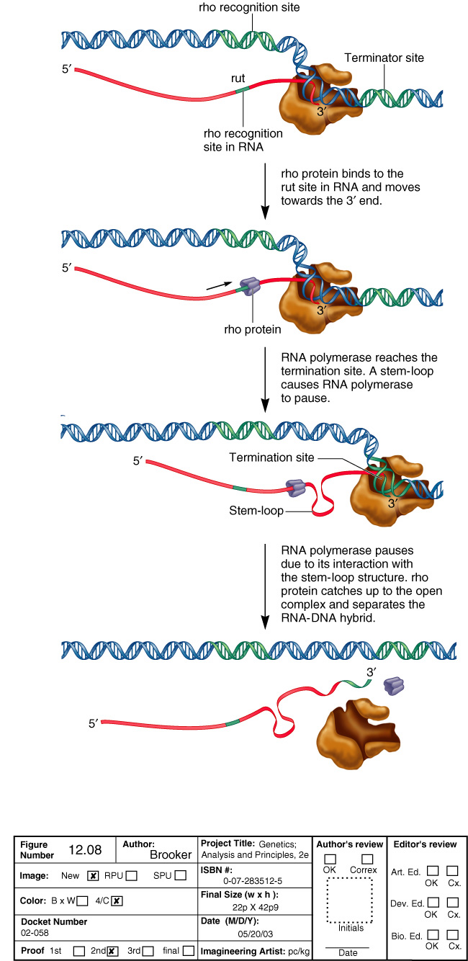
Rho Dependent Termination in Prokaryotes
rho utilization site
Rho protein is a helicase
ρ-dependent termination

Slide 19
Rho Dependent Termination in Prokaryotes
ρ-dependent termination

Slide 20
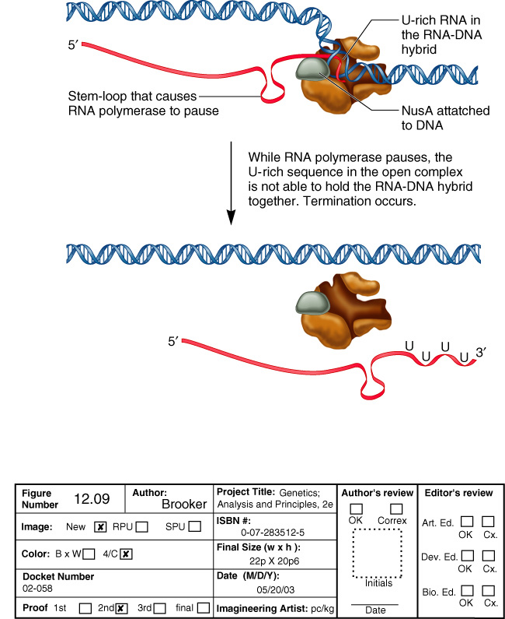
Rho Independent Termination in Prokaryotes
ρ-independent termination requires two sequences in the RNA
  A stem-loop structure upstream of 7-9 U residues
NusA
Stabilizes the RNA pol pausing
ρ-independent termination

Slide 21
Eukaryotic Promoters
RNA Pol I
  rRNA precursor
RNA Pol II
  mRNAs,
  U6 snRNA
RNA Pol III
  tRNA, 5S rRNA, U1-U5 snRNAs
Pol I
UBF
SL1
UCE
Core
45S rRNA
precursor
Pol II
GSTFs
TFIID
UAS
TATA
box
pre-mRNA
Pol III
TFIIIB
TFIIIC
A
B
tRNA
precursor

Slide 22
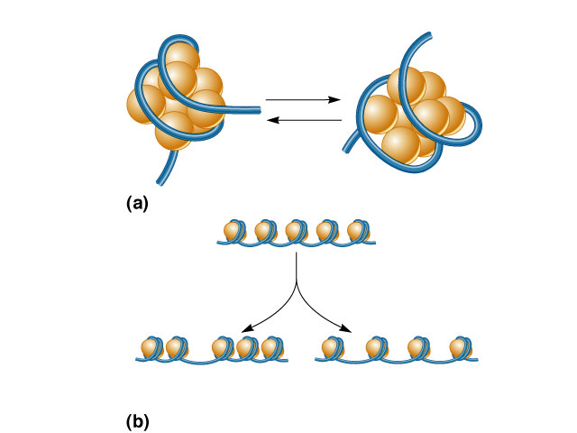
Chromatin Structure Affects Promoter Access
Core histone
proteins
COCH₃
Histone
acetyltransferase
COCH₃
COCH₃
COCH₃
COCH₃
COCH₃
COCH₃
Histone
deacetylase
COCH₃
COCH₃
COCH₃
COCH₃
Acetyl
group
Histone acetylation
ATP-dependent
chromatin remodeling
complex
Change in the relative positions
of a few nucleosomes
Change in the spacing of
nucleosomes over a long distance
Chromatin remodeling

Slide 23
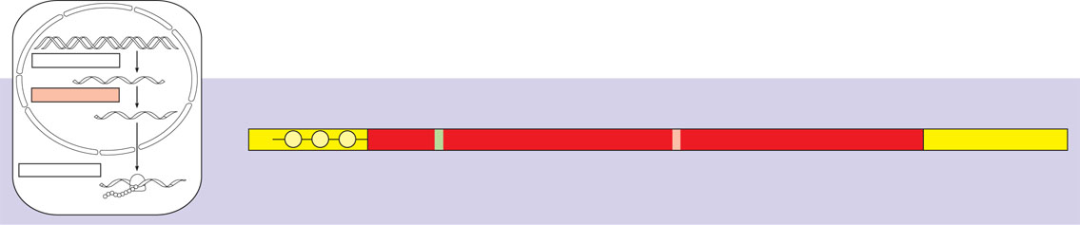
RNA processing: addition of the 5′ cap and poly-A tail
A modified guanine nucleotide
added to the 5′ end
50 to 250 adenine nucleotides
added to the 3′ end
TRANSCRIPTION
DNA
RNA PROCESSING
Pre-mRNA
5′
Protein-coding segment
Polyadenylation signal
3′
mRNA
G
P
P
P
AAUAAA
AAA…AAA
TRANSLATION
Ribosome
Start codon
Stop codon
5′ Cap
5′ UTR
3′ UTR
Poly-A tail
Polypeptide

Slide 24
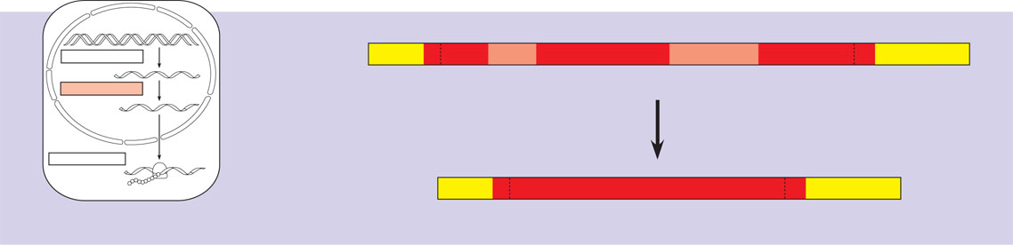
RNA processing: RNA splicing
5′
Exon
Intron
Exon
Intron
Exon
3′
TRANSCRIPTION
DNA
Pre-mRNA
5′ Cap
Poly-A tail
1
30
31
104
105
146
RNA PROCESSING
Pre-mRNA
mRNA
Coding
segment
Introns cut out and
exons spliced together
TRANSLATION
Ribosome
Polypeptide
mRNA
5′ Cap
Poly-A tail
1
146
3′ UTR
3′ UTR

Slide 25
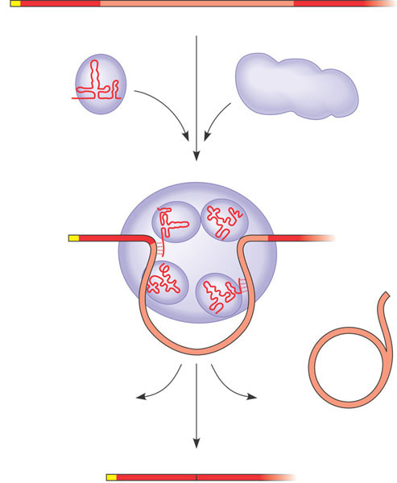
The roles of snRNPs and spliceosomes in pre-mRNA splicing
RNA transcript (pre-mRNA)
5′
Exon 1
Intron
Exon 2
Protein
1
snRNA
Other proteins
snRNPs
Spliceosome
2
5′
Spliceosome
components
Cut-out
intron
3
mRNA
5′
Exon 1
Exon 2

Slide 26
Regulation of Translation

